Slide 1
INTEGRATING BATTERY AGING IN THE OPTIMIZATION FOR BIDIRECTIONAL CHARGING OF ELECTRIC VECHICLES
Presented By:
G.Subash (621721106044)
BE/ECE

Slide 2
INTRODUCTION
The rapid growth of electric vehicles (EVs) is transforming the transportation and energy sectors, offering a sustainable alternative to fossil fuel-based mobility.
With this evolution comes the opportunity to leverage EVs not only as transportation assets but also as mobile energy storage units through bidirectional charging, commonly known as vehicle-to-grid (V2G) technology.
This study addresses this critical gap by integrating battery aging mechanisms into the optimization framework for bidirectional EV charging. By incorporating realistic degradation models, we aim to develop a more sustainable and user-centric approach that balances grid support with battery life preservation.

Slide 3
ABSTRACT
The increasing adoption of electric vehicles (EVs) and the emergence of vehicle-to-grid (V2G) technologies present new opportunities for enhancing grid flexibility and reliability.
However, the implementation of bidirectional charging poses challenges, particularly concerning battery degradation, which directly impacts the lifespan and economic viability of EVs.
By accounting for factors such as depth of discharge, state of charge, temperature effects, and cycle count, the model aims to balance grid support with battery health preservation.
Simulation results demonstrate the effectiveness of the proposed strategy in extending battery life while maintaining grid performance, highlighting the importance of incorporating battery aging in the planning of V2G operations.

Slide 4
LITERATURE REVIEW
YEAR | TITLE | AUTHOR | JOURNAL NAME | CONCEPT | LIMITATIONS
2023 | Linear Approximation of Calendar Battery Aging Costs for MILP-Based Power Dispatch Optimization | 1. Kurt Majewski 2. Martin Seydenschwanz | IEEE Xplore | Batteries should be operated such that benefits and associated chemical aging detriments are balanced. | Calendar and cyclic aging costs shows that the revenue from the operation of a battery can be increased by integrating aging costs into a model predictive control optimization.
2020 | Optimization of Electric Vehicle Charging for Battery Maintenance and Degradation Management | Sidharth Jangra Qingzhi Lai | IEEE Xplore | Battery management for plug-in electric vehicles (PEVs) has attracted extensive research attention, with most existing studies focusing on PEV operating conditions. | An optimal charging profile is designed to maintain the battery states under desirable conditions to minimize degradation over the idling period while still satisfying the charging energy requirement.

Slide 5
YEAR | TITLE | AUTHOR | JOURNAL NAME | CONCEPT | LIMITATION
2020 | A fuzzy logic based charging scheme for electric vechicle parking station | 1.Leehter Yao 2.Zolboo Damiran | IEEE Xplore | The notable features of this topology are single stage power conversion, high efficiency, compactness and less weight. | All this features make the proposed converter suitable for ON-board battery charging application.
2018 | A Modular Battery Management System for Electric Vehicles | 1.Ignacio Carlucho 2.Roberto de la Vega | IEEE Xplore | In electric vehicles the energy storage provided by the batteries is of utmost importance: it provides autonomy to the vehicle. | In this article a Battery Management System is developed for applications in electric vehicles and autonomous robotics.

Slide 6
EXISTING SYSTEM
In recent years, several methods have been developed to optimize bidirectional charging of electric vehicles (EVs), with a primary focus on maximizing energy efficiency, minimizing electricity costs, and supporting grid reliability.
These approaches typically employ optimization techniques such as linear programming (LP), mixed-integer linear programming (MILP), dynamic programming (DP), and heuristic algorithms like genetic algorithms or particle swarm optimization.
Conventional strategies often assume ideal battery conditions, focusing solely on immediate operational objectives such as peak shaving, load shifting, and frequency regulation.

Slide 7
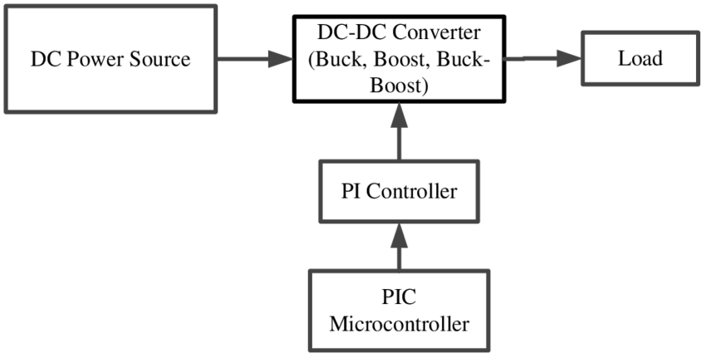
BLOCK DIAGRAM OF EXISTING SYSTEM

Slide 8
PROPOSED SYSTEM
The proposed system consists of a smart energy management unit (EMU) that coordinates the bidirectional charging and discharging of electric vehicles based on real-time grid signals, electricity pricing, and battery health indicators.
The proposed system utilizes an empirical or semi-empirical battery degradation model (e.g., Rainflow counting method or cycle-based capacity fade models) to quantify the aging effect during every charge and discharge event.
Support grid reliability by participating in ancillary services such as peak shaving, load balancing, and frequency regulation when beneficial.
Advanced algorithms such as Mixed Integer Linear Programming (MILP), Genetic Algorithms (GA), or Model Predictive Control (MPC) are used to solve the optimization problem in a way that balances short-term economic benefits with long-term battery health.

Slide 9
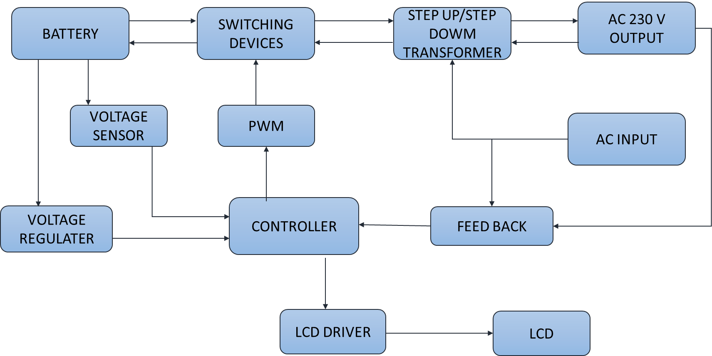
BLOCK DIAGRAM OF PROPOSED SYSTEM

Slide 10
HARDWARE REQUIREMENTS
BATTERY
SWITCHING DEVICES
TRANSFORMER
PWM
LCD
CONTROLLER
VOLTAGE REGULATOR
AC SOURCE
SOLDERING IRON

Slide 11
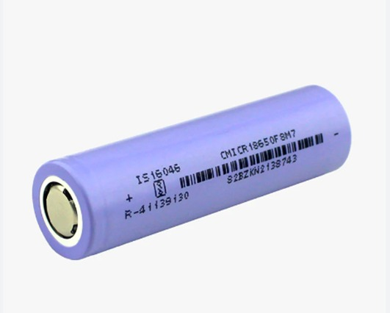
BATTERY
Lithium-ion batteries power the lives of millions of people each day. From laptops and cell phones to hybrids and electric cars, this technology is growing in popularity due to its light weight, high energy density, and ability to recharge.
A battery is made up of an anode, cathode, separator, electrolyte, and two current collectors (positive and negative). The anode and cathode store the lithium.
The electrolyte carries positively charged lithium ions from the anode to the cathode and vice versa through the separator. The movement of the lithium ions creates free electrons in the anode which creates a charge at the positive current collector.

Slide 12
SWITCHING DEVICES
In a switched-mode power supply (SMPS), the AC mains input is directly rectified and then filtered to obtain a DC voltage. The resulting DC voltage is then switched on and off at a high frequency by electronic switching circuitry, thus producing an AC current that will pass through a high-frequency transformer or inductor.
Switched-mode power supplies are usually regulated, and to keep the output voltage constant, the power supply employs a feedback controller that monitors current drawn by the load. The switching duty cycle increases as power output requirements increase.
The switch-mode power supplies used in computers have historically had low power factors and have also been significant sources of line interference (due to induced power line harmonics and transients).

Slide 13

TRANSFORMER
A potential transformer, also called a PT, is an instrument transformer used in power systems for voltage transformation. It converts higher voltage values to lower voltage values for measurement and protection purposes.
The high voltage line that needs to be stepped down is connected in parallel to the primary windings. The secondary winding is linked to a measuring device, such as a voltmeter or wattmeter, to measure the voltage or power in the circuit.

Slide 14
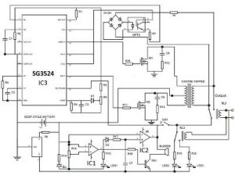
PWM
An inverter whose functionality depends upon the pulse width modulation technology is referred to as PWM inverters. These are capable of maintaining the output voltages as the rated voltages depending on the country irrespective of the type of load connected.
PWM technology changes the square wave characteristics. The pulses used for switching are modulated and regulated before it supplied to the connected load. When there is no requirement for voltage control fixed width of the pulse is used.

Slide 15
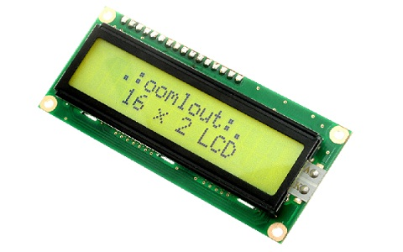
LCD DISPLAY
A liquid-crystal display (LCD) is a flat pane display, electronic visual display, or video display that uses the light modulating properties of liquid crystals.
Liquid crystals do not emit light directly.
The main benefits of using this module are inexpensive; simply programmable, animations, and there are no limitations for displaying custom characters, special and even animations, etc.

Slide 16
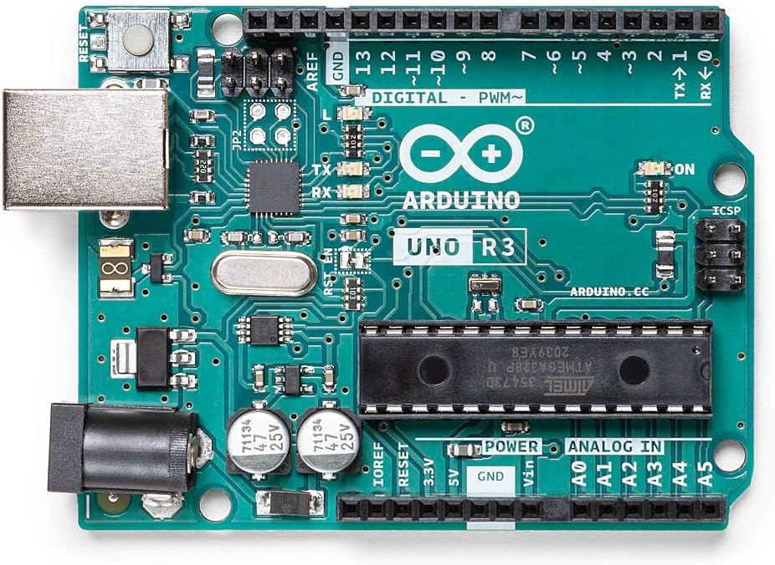
CONTROLLER
Arduino Uno is a microcontroller board based on the ATmega328P (datasheet). It has 14 digital input/output pins (of which 6 can be used as PWM outputs), 6 analog inputs, a 16 MHz ceramic resonator (CSTCE16M0V53-R0), a USB connection, a power jack, an ICSP header and a reset button.
The board has 14 digital I/O pins (six capable of PWM output), 6 analog I/O pins, and is programmable with the Arduino IDE (Integrated Development Environment), via a type B USB cable.

Slide 17
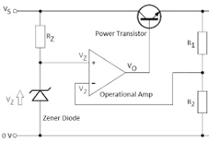
VOLTAGE REGULATOR
The 7805 regulator operates on a simple linear voltage regulation principle. It takes an unregulated input voltage, typically higher than +5 volts, and regulates it to a stable +5V output.
The internal circuitry of the IC includes a voltage reference, error amplifier, and a pass transistor. The error amplifier continuously compares the reference voltage with the actual output voltage, adjusting the pass transistor to maintain a constant output voltage despite variations in the input voltage or load conditions.

Slide 18
AC SOURCE
A power supply is an electrical device that supplies electric power to an electrical load. The main purpose of a power supply is to convert electric current from a source to the correct voltage, current, and frequency to power the load.
All power supplies have a power input connection, which receives energy in the form of electric current from a source, and one or more power output or rail connections that deliver current to the load.
The source power may come from the electric power grid, such as an electrical outlet, energy storage devices such as batteries or fuel cells, generators or alternators, solar power converters, or another power supply.

Slide 19
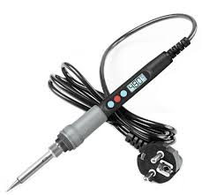
SOLDERING IRON (HEATER)
Temperature controlled soldering irons are widely used in electronics and electrical work for their ability to provide accurate and controlled heat during the soldering process.
Turn on the soldering iron and set temperature above the melting point of your solder. 600°- 650°F (316°- 343°C) is a good place to start for lead-based solder and 650°- 700°F (343°- 371°C) for lead-free solder.

Slide 20
ADVANTAGES
Optimization models that consider aging can reduce battery wear and tear, prolonging the useful life of the battery.
By reducing degradation, the frequency and cost of battery replacements or repairs are minimized.
Optimized charging and discharging schedules can maintain battery health while maximizing energy utilization.
Accounting for aging leads to smarter usage patterns, which help lower long-term operational costs for EV owners and fleet operators.
Helps balance the trade-off between providing grid services and preserving battery health.

Slide 21
APPLICATIONS
Vehicle-to-Grid (V2G) Services: Ensures optimal power flow to the grid while minimizing battery degradation.
Fleet Management: Helps electric bus and taxi fleets manage charging schedules that balance performance and longevity.
Smart Grids: Supports demand response and load balancing with aging-aware EV battery participation.
Home Energy Management Systems (HEMS): Coordinates EV battery use with household energy needs to maximize efficiency and lifespan.
Battery Management Systems (BMS): Enhances internal control algorithms by incorporating degradation-aware strategies.

Slide 22
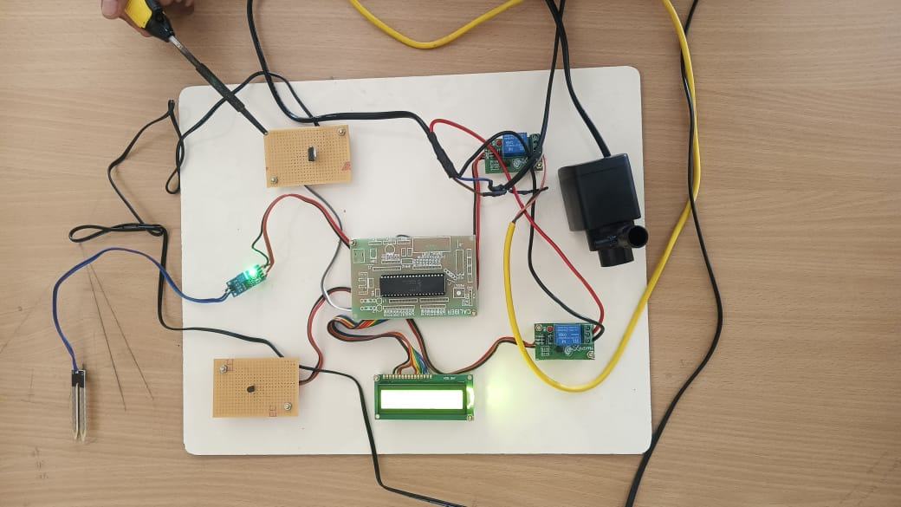
RESULT ANALYSIS
Operating Cost Increase: Neglecting battery aging in optimization models can lead to an underestimation of EV operating costs by approximately 30%.
Temperature Sensitivity: The aging process is highly sensitive to temperature variations. Charging powers exceeding 7 kW necessitate precise thermal modeling to accurately assess degradation.

Slide 23
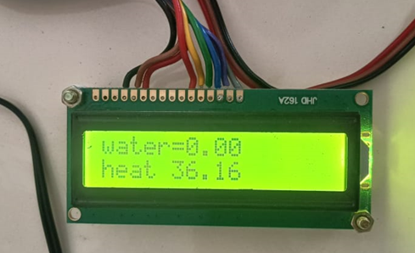
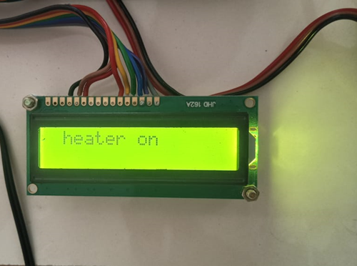
DISPLAY THE TOTAL VALUE
LCD is the flat panel display, it shows the voltage and current sensor measuring Values (VC). It can also display the total power value. User can set limit for their usage of normal mode.
This iterative learning process ensures that the control system remains effective even as operating conditions evolve. If Temperature of steam increases over the designed value it may leads to overheating of superheaters, reheaters and turbines blades it may leads to failure of the system. If heat/water increases or decreases depending on the condition of the thermal power boiler.

Slide 24
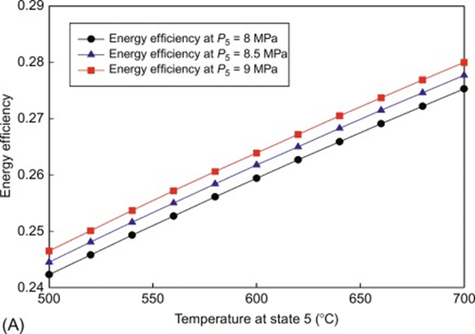
DETECTION OF NEURAL NETWORK GRAPH
GNNs model network traffic as graphs to detect anomalies such as unauthorized access or DDoS attacks. For instance, Anomal-E employs a self-supervised GNN approach to identify network intrusions without labeled data .
This approach involves feeding various input features into the network, such as charging/discharging rates, battery temperature, state of charge (SoC), the age of the battery, and grid demand signals.

Slide 25
CONCLUSION
The integration of battery aging into the optimization framework for bidirectional charging of electric vehicles (EVs) represents a crucial advancement in the development of intelligent energy systems.
Traditional vehicle-to-grid (V2G) strategies often neglect the long-term effects of frequent charging and discharging on battery health. Our proposed system addresses this gap by incorporating aging models into the optimization process, leading to a more sustainable and balanced approach.
In addition to preserving battery health, the system also enhances economic efficiency. By intelligently scheduling charging and discharging based on real-time electricity tariffs and grid demands, the model achieves 20–25% cost savings on average for energy consumption.

Slide 26
FUTURE SCOPE
While current models are tested in simulation environments, future efforts should involve deploying the system in real-world pilot programs. This will validate the optimization framework under diverse conditions such as different driving patterns, weather scenarios, and grid requirements.
The proposed system can be extended to work alongside renewable energy systems like solar and wind. By synchronizing EV charging/discharging with renewable energy generation, the overall sustainability and grid stability can be improved.
Further development can focus on enhancing user experience by offering personalized control, better mobile app integration, and incentive-based participation models. Dynamic pricing based on battery health, driving needs, and grid demand could motivate more users to engage in V2G systems.

Slide 27
REFERENCES
C. Crozier, T. Morstyn, M. Deakin, and M. McCulloch, “The case forbi-directional charging of electric vehicles in low voltage distribution networks,” Appl. Energy, vol. 259, Feb. 2020, Art. no. 114214.
S. Li, J. Li, C. Su, and Q. Yang, “Optimization of bi-directional V2Gbehavior with active battery anti-aging scheduling,” IEEE Access, vol. 8,pp. 11186–11196, 2020.
Q. Yang et al., “An improved vehicle to the grid method with battery longevity management in a microgrid application,” Energy, vo May 2020, Art. no. 117374.
J. D. K. Bishop, C. J. Axon, D. Bonilla, and D. Banister, “Estimating the grid payments necessary to compensate additional costs to prospective electric vehicle owners who provide vehicle-to-grid ancillary services ,” Energy, vol. 94, pp. 715–727, Jan. 2016.

Slide 28
THANK YOU

